Slide 1
AN INTERACTIVE EXPLORATION
GMM
A SMAI Project by Shreyas Reddy Palley & Akshat Sanghvi

Slide 2
Table of contents
01
02
03
04
05
06
Problem Statement
Project Deliverables
Details & Progression
Development Timeline
Visual
Demos
Final Thoughts & Conclusion

Slide 3
Key Terms
GMM → Gaussian Mixture Model
EM → Expectation Maximization Algorithm
Notes:
including visualizations of how GMM components adapt to data

Slide 4
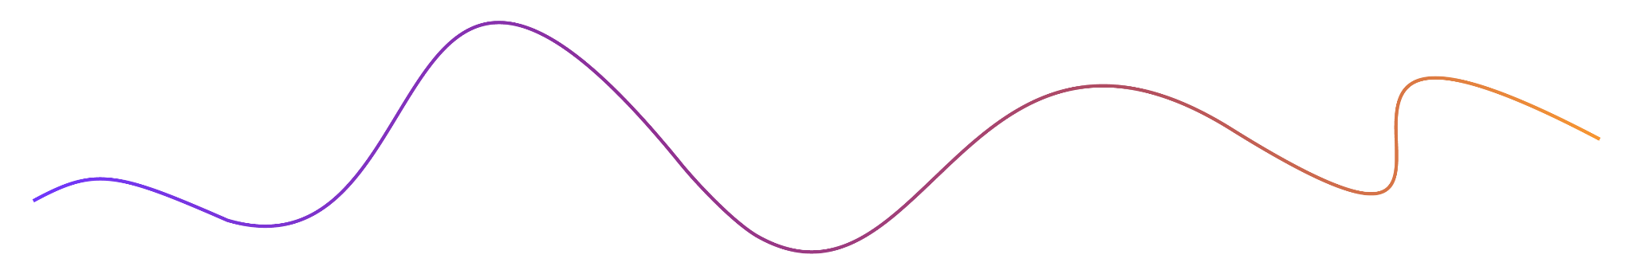
01
Problem Statement

Slide 5
Introduction
Problem Statement
Motivation
Design and create an interactive web-based tool guiding users through the theory and implementation of Gaussian Mixture Models for clustering, including visualizations of how GMM components adapt to data
Aid our audience (students, academics, teachers) visualize Gaussian Mixture Models and develop an intuitive understanding using our tools
Notes:
including visualizations of how GMM components adapt to data

Slide 6
02
Project Deliverables

Slide 7
Project Deliverables
Blog
The main guide to explaining the theories and concepts behind GMM with EM algorithm. Contains both our embedded web tools and visualizations
Blog
Interactive Web Tool
Interactive Web Tools
Web-based tools to visualize GMM clustering on 1D and 2D data. Work for N Dimensional Data using PCA
Visualizations
Visualizations
Visualize concepts of Gaussians/Gaussian Mixture Models such as varying parameters
Notes:
Blog -> Covers motivation. For N-Dimensional Data as input, it performs PCA and visualizes output of GMM fitting with EM algorithm
Visualizatoins -> and various visualizations

Slide 8
03
Details & Progression

Slide 9
GMM
1D Data
2D Data
ND Data
Vary number of clusters
Default or Input data from file input/text input
Controls for iteration navigation
Web Tool Visualization Features
Notes:
The tool performs dimensionality reduction to convert it to 2D with 2 principal components

Slide 10
Motivating using CLT (Central Limit Theorem)
Explaining General EM Algorithm
Explain EM Algorithm with GMM
Explain 1D, 2D, ND Data GMM clustering
Theory Content Features
Notes:
The tool performs dimensionality reduction to convert it to 2D with 2 principal components

Slide 11
Manim Library → Python
Manim Web → Dart
Manim Web → Poorly Implemented
Open Source Contributions
Manim Web
Notes:
Manim web is a browser based implementation of Manim that had the potential for interactivity. It was created in a month by a man named Hugo who used bad foundations to replicate manim.
Hence, I decided to fork manim web and rewrite the library for my convenience. The Difficulty of our project was supposed to be creating a convincing lesson but now our problem shifted to rewriting this library.
Open Source Contributions:

Slide 12
Implemented Vectorized GMM for 1D and ND data in the Dart programming language from scratch
Implemented PCA for dimensionality reduction of this ND data
Normalization Methods for ease of visualization in web tools
GMM & PCA Implementation
Notes:
allowing for multiimensional data as input
and manim

Slide 13
Integrated 2 Different pipelines for Dart Manim Web implementation
Rewrote command line manim functionality
This 2nd pipeline built from scratch and allows for file input & DOM manipulation
Pipelines
Notes:
The tool performs dimensionality reduction to convert it to 2D with 2 principal components

Slide 14
04
Development Timeline

Slide 15
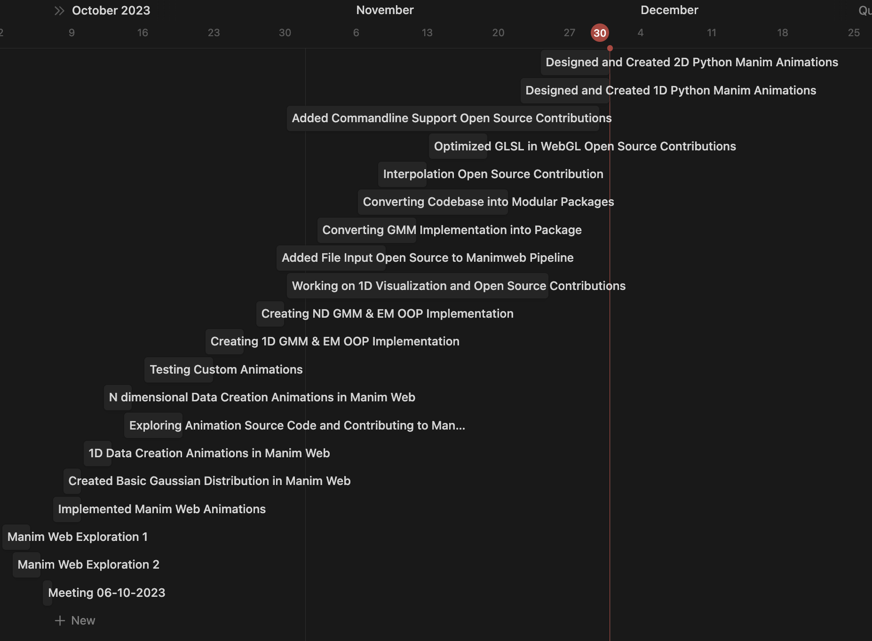
Development Timeline
Notes:
Within the blog,

Slide 16
05
Visual
Demos

Slide 17
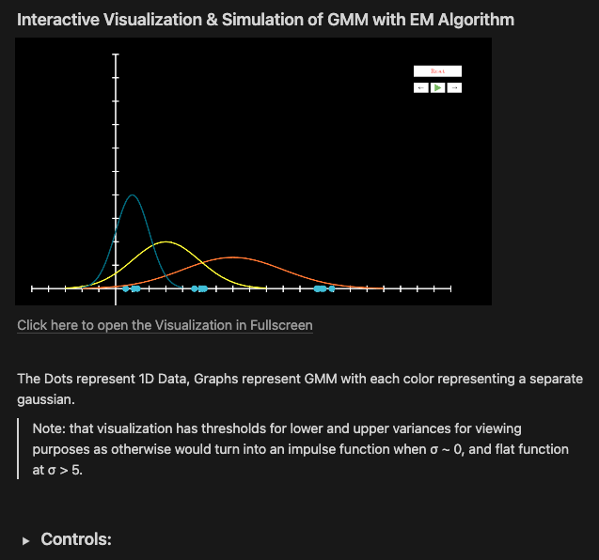
Blog
Our blog contains all of our theory content, interactive web tools, and general visualizations

Slide 18
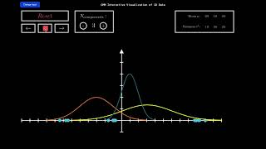
Web Tools (1D)
1D Web Tool takes 1 dimensional data and clusters GMM on them. User can vary Number of Components and go forward, backward through iterations. Also visualizes means and variances of each GMM

Slide 19
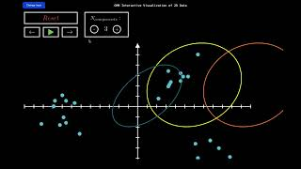
Web Tools (2D)
2D Web Tool takes 2 dimensional data and clusters GMM on them. User can vary Number of Components and go forward, backward through iterations.

Slide 20
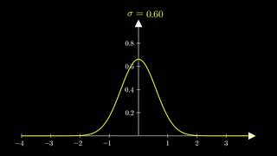
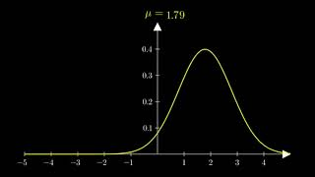
1D Visualizations

Slide 21
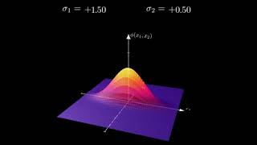
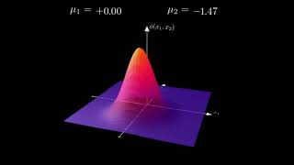
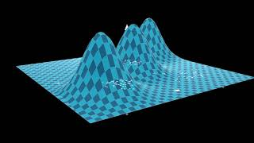
2D Visualizations

Slide 22
Deliverables
Blog
1D Web Tool
2D Web Tool
https://gmmvisualization.simple.ink/
https://deafspy.github.io/projects/gmm/gmm1D.html
https://deafspy.github.io/projects/gmm/gmm2D.html
Notes:
Within the blog,

Slide 23
06
Final Thoughts & Conclusion

Slide 24
Conclusions
Summary
Applications
Future Directions
We have created a broad set of tools & visualizations that can be used by anyone to learn about GMM and grasp an intuitive understanding
To visualize High-quality GMM clustering on various datasets
Can be used by teachers/professors to provide guiding material for students
We believe in the potential of Manim Web, and we would like to continue its open source development so others can produce high quality interactive visualizations
Notes:
Within the blog,

Slide 25
THANK
YOU

